Slide 1
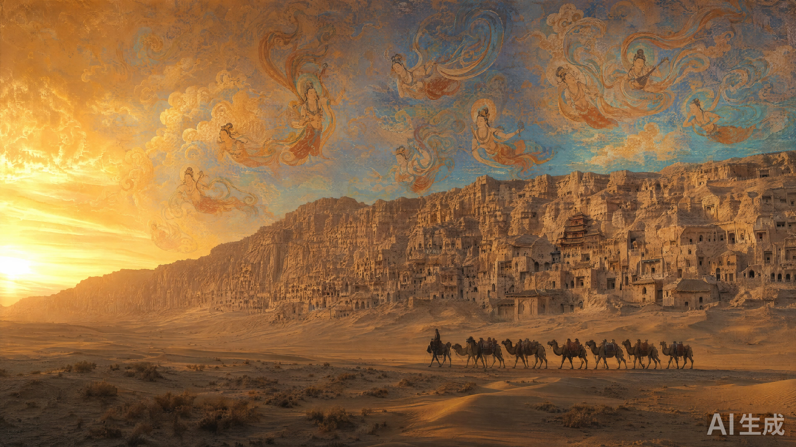
Dunhuang Art & the Silk Road
DUNHUANG · SILK ROAD CIVILIZATION
Teaching Slides · General Education | Dark Gold · Azurite · Ochre

Slide 2
Course Introduction
From 138 BCE, when Zhang Qian pierced the West, to 366 CE, when the Mogao Grottoes began, to today's millimeter-level digital capture —
this course spans eight eras, inviting you to gaze upon a civilizational dialogue lasting over two thousand years.
• Exposition · AI voice narration · HD mural details | Interactive Silk Road map · 30 cities | Digital relic gallery · 40 items
Dark Gold
Azurite
Ochre

Slide 3
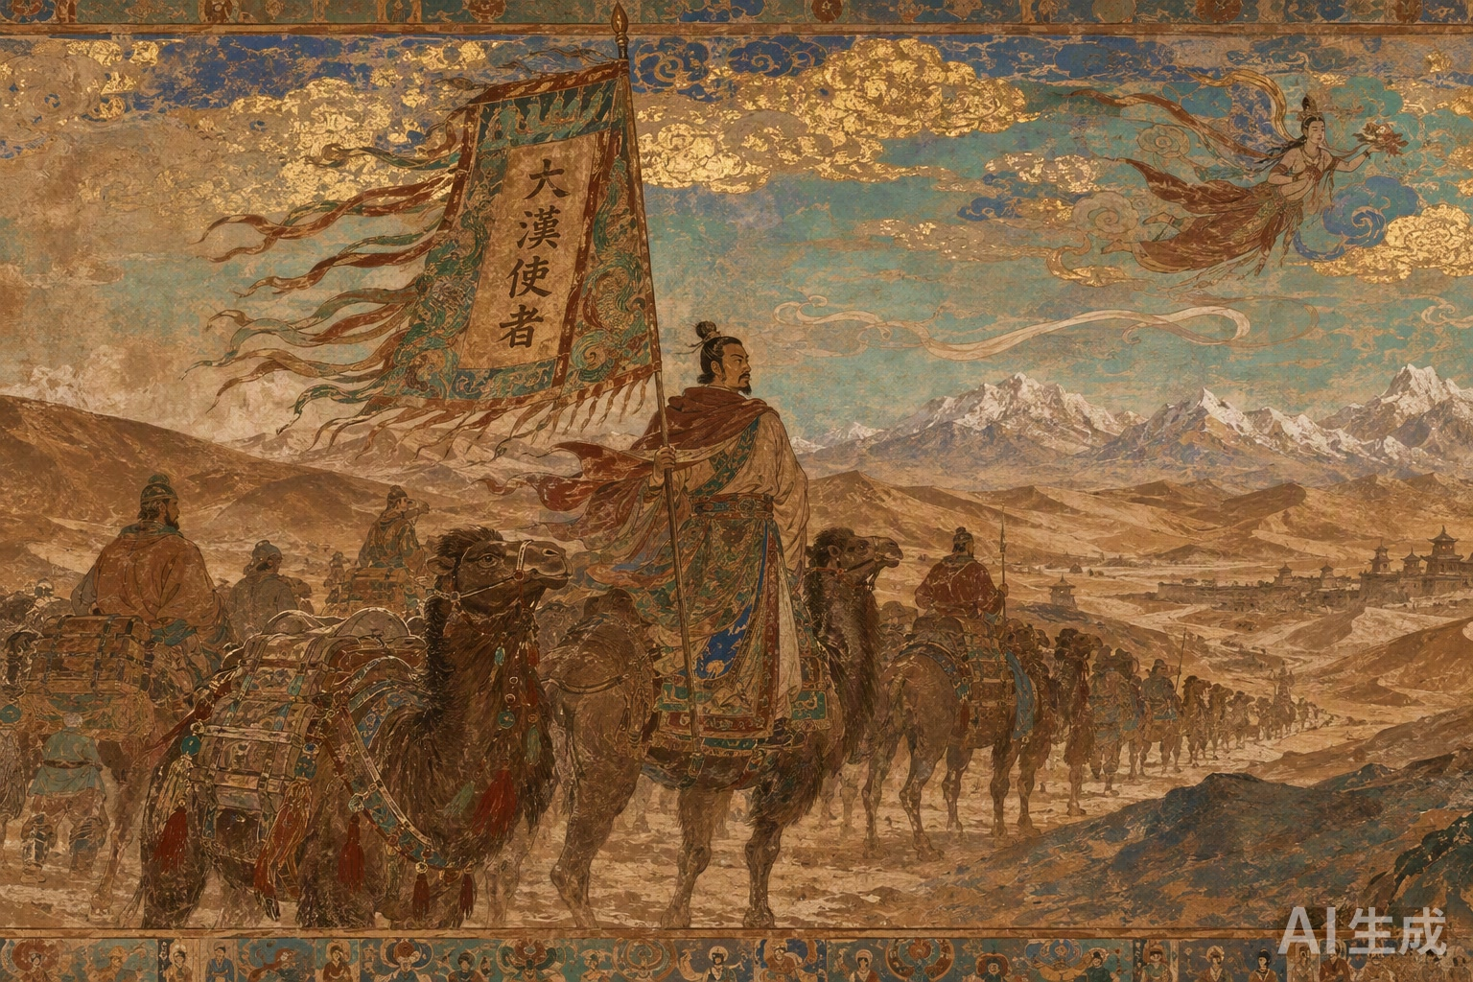
Chapter I · Western Han
Zhang Qian's Mission
Bridging the West, Opening the Silk Road
In 138 BCE, Emperor Wu sent Zhang Qian west to ally with the Great Yuezhi against the Xiongnu. Twice detained over thirteen years, he failed the military aim but brought back the Central Plains' first systematic knowledge of the West — history calls it the Piercing.
01 / 08

Slide 4
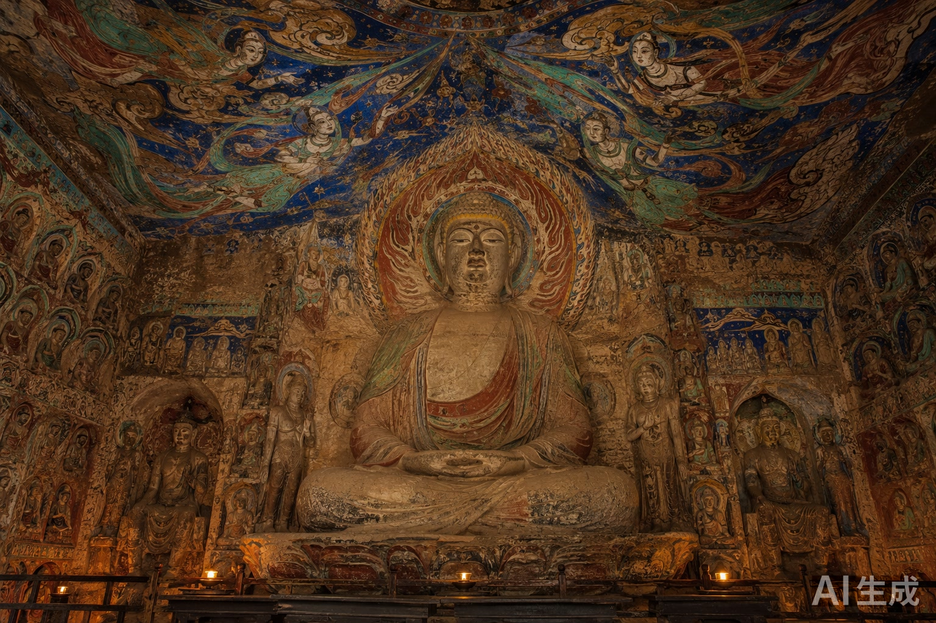
Chapter II · Wei-Jin
Wei-Jin Grottoes
First Light of the Dharma, Mogao Begins
In 366 CE, the monk Le Zun carved the first cave at Mogao, launching a thousand-year cave-making movement. The early caves are mostly central-pillar caves; murals center on jataka and Maitreya.
02 / 08

Slide 5
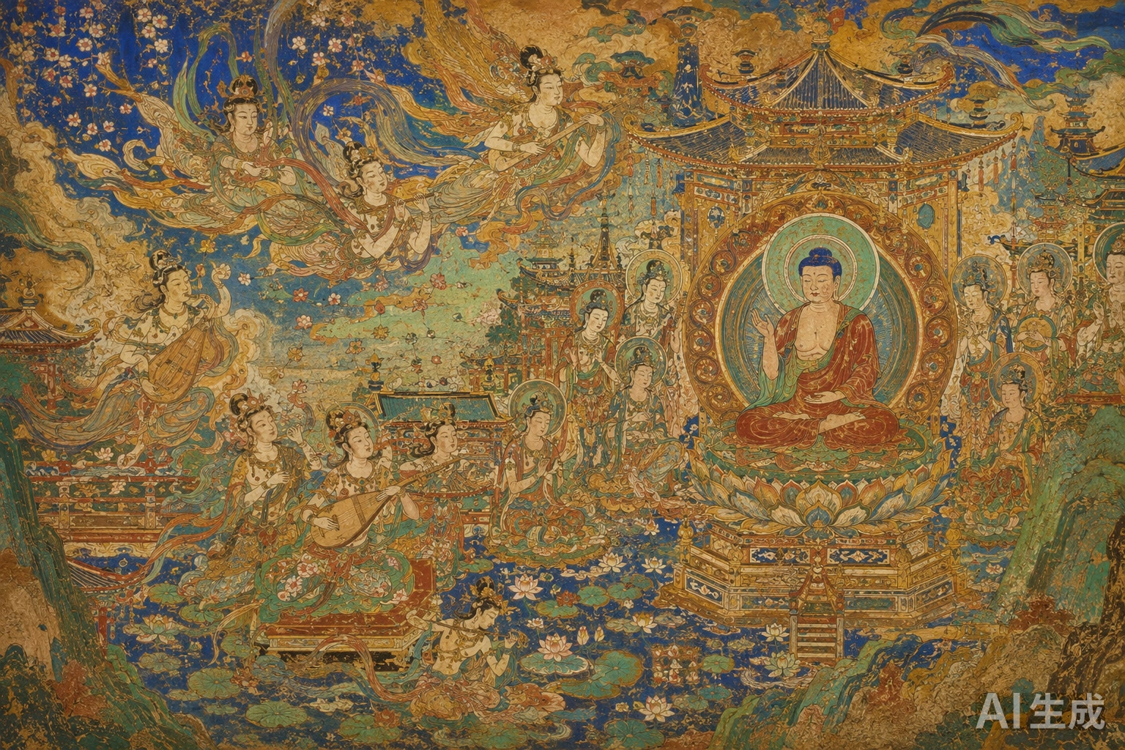
Chapter III · High Tang
High Tang Sutra-Tableaux
Sounds of Splendor Fill the Pure Land
At the height of Tang power, sutra-tableaux replace story paintings at scale, depicting Pure Lands in sweeping compositions. The apsaras, wingless, soar on scarves — a super-symbol of Eastern aesthetics.
03 / 08

Slide 6
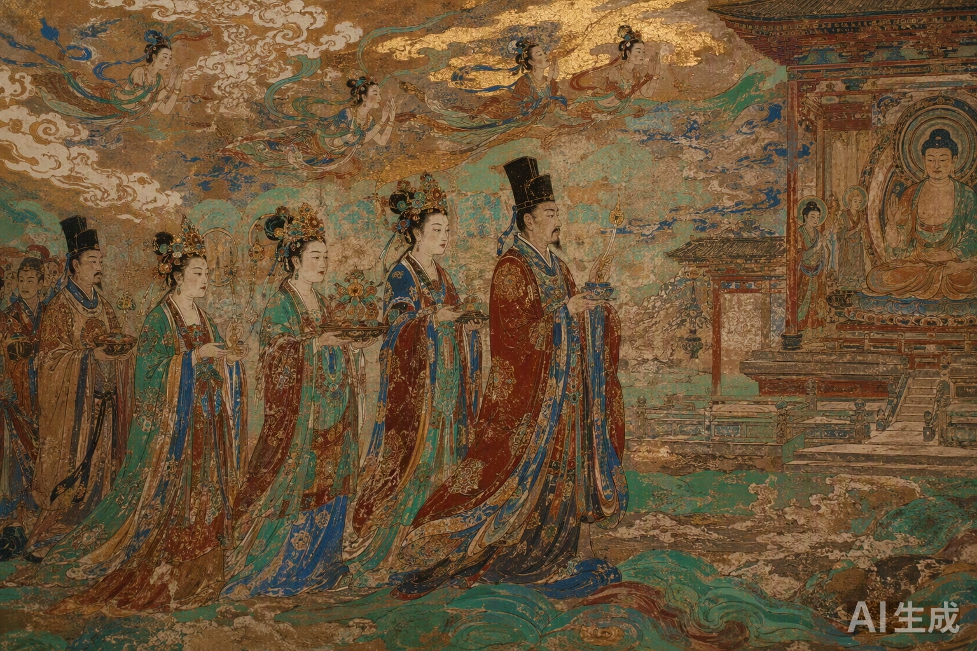
Chapter IV · Five Dynasties
Five Dynasties Donors
The Cao Painting Academy, Patrons Preserved
The Guiyijun Cao clan set up a painting academy; donor portraits multiply, becoming a precious archive for the study of dress, society, and Silk Road marriage alliances.
04 / 08

Slide 7
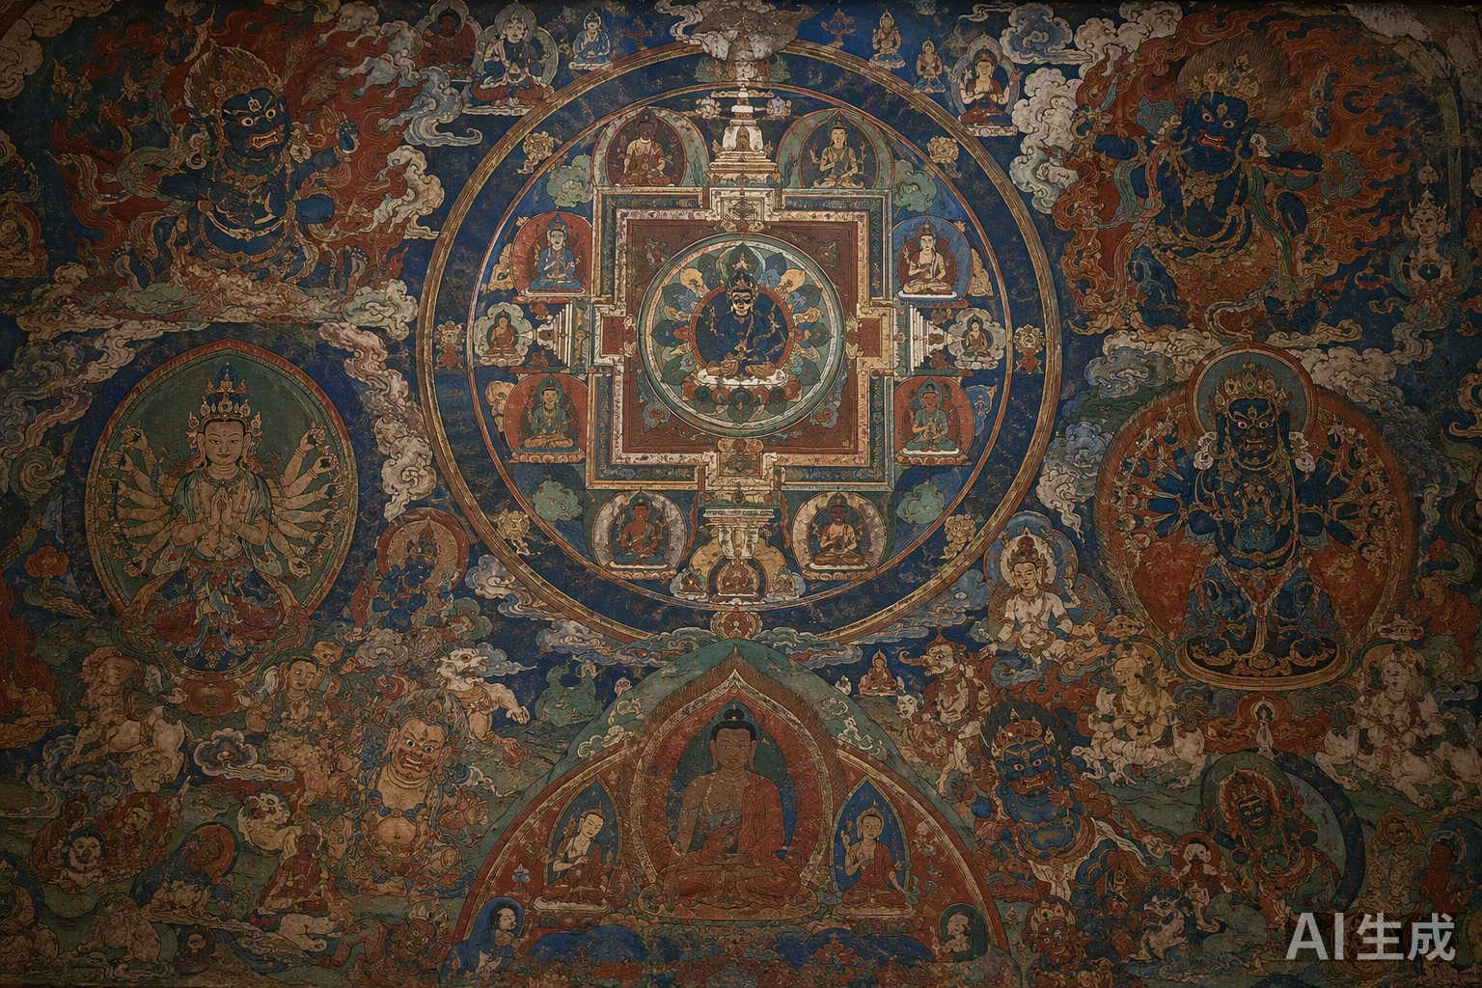
Chapter V · Western Xia–Yuan
Western Xia & Yuan-Mongol
Esoteric Buddhism East, Mandalas Rise
Tibetan esoteric Buddhism spread east along the Hexi; the Yuan honored the Sakya school. Yulin mandalas hold the dharma-realm in rigorous geometry, with Han-Tibetan mixed brushwork.
05 / 08

Slide 8
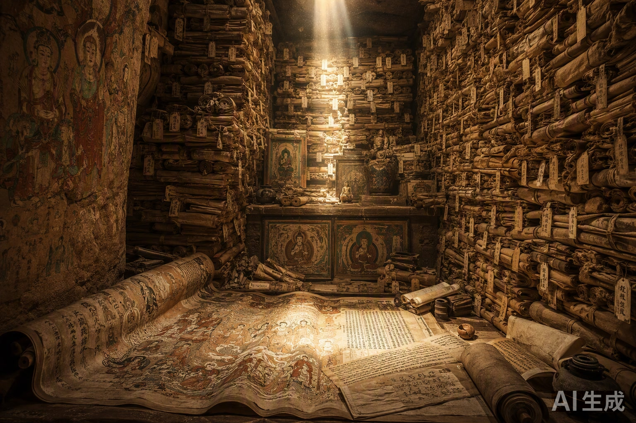
Chapter VI · Early Northern Song
The Library Cave
Sealed a Millennium, Revealed Anew
In 1900, the priest Wang Yuanlu chanced upon Cave 17, holding over 50,000 manuscripts and silk paintings from the 4th–11th centuries — the medieval Eastern library — and Dunhuang Studies was born.
06 / 08

Slide 9
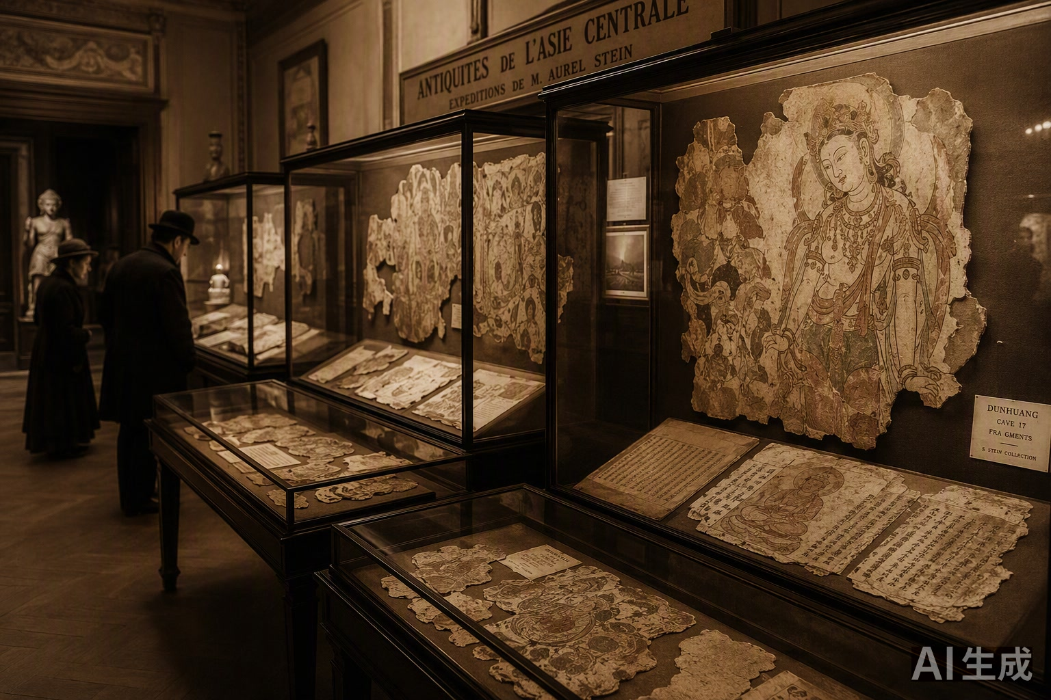
Chapter VII · Modern
Modern Dispersal
Treasures Dimmed, a Painful Chronicle
Stein, Pelliot, and others carried off masses of Dunhuang treasures to Western collections — the most painful chapter in China's modern cultural-property history. In 1944 the National Dunhuang Art Institute was founded.
07 / 08

Slide 10
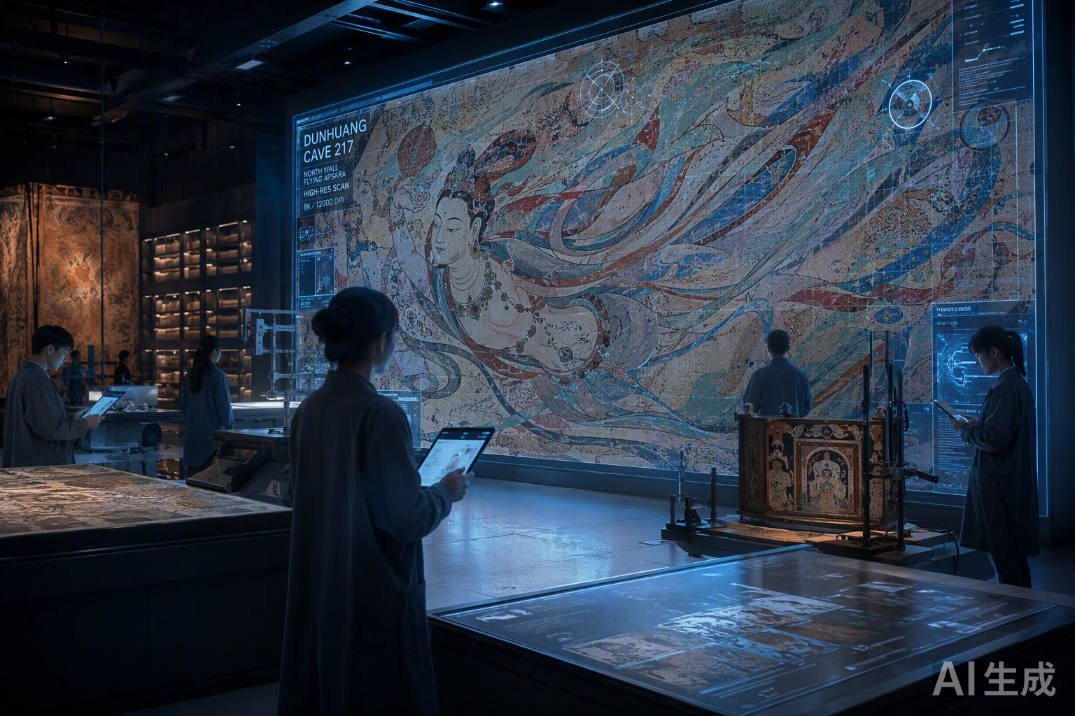
Chapter VIII · Contemporary
Contemporary Digitization
Digital Immortality, Dunhuang in the Cloud
The Digital Dunhuang project captures all caves at millimeter-level high resolution, building the world's largest digital repository of grotto art — granting the murals immortality in the cloud and sharing them globally.
08 / 08

Slide 11
The Scale of Dunhuang
735
45,000㎡
2,415
50,000+
1987
Caves
Murals
Statues
Library Cave docs
World Heritage
The largest and richest treasury of Buddhist art in the world.
Digital Dunhuang captures all caves at millimeter-level resolution, building the world's largest digital repository — immortality in the cloud.

Slide 12
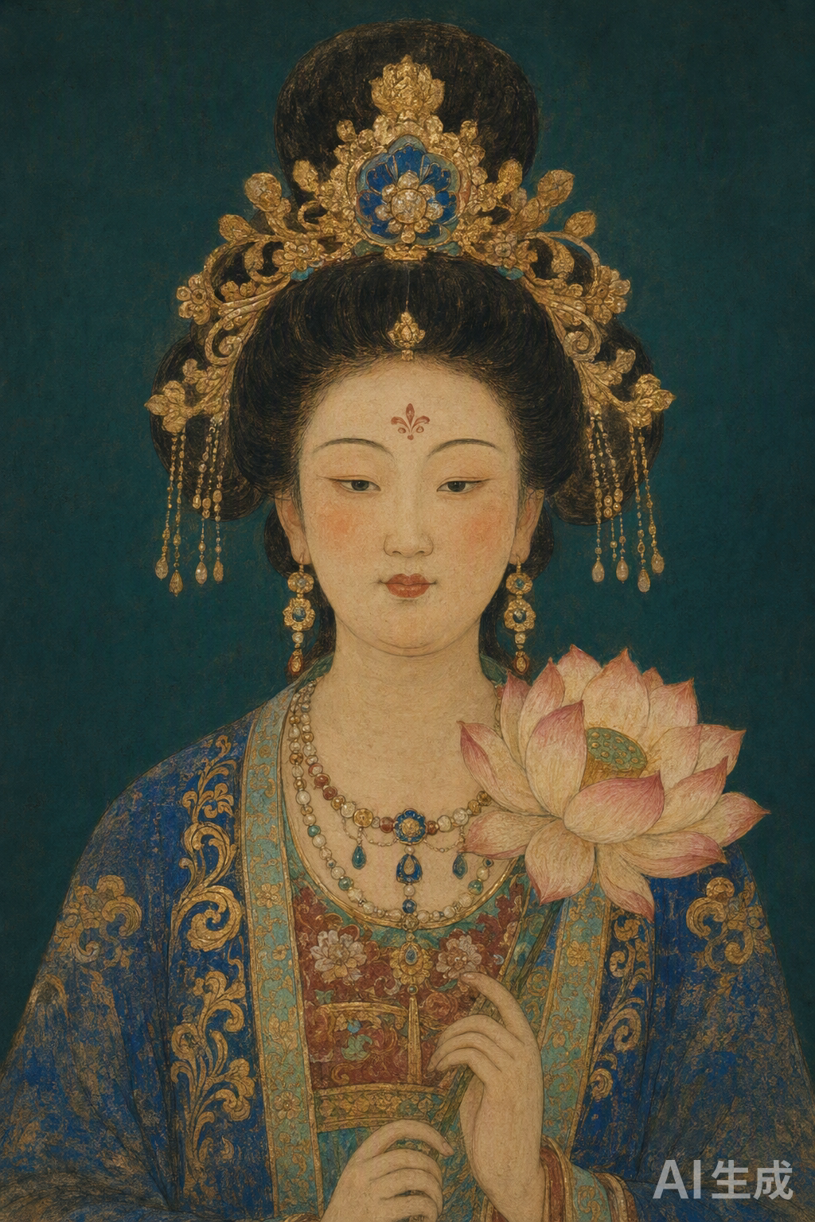
Conclusion From Stewardship to Immortality
From Zhang Qian's Piercing to Le Zun's first cave, from the High Tang sutra-tableaux to the sealing of the Library Cave, from modern dispersal to digital immortality —
Dunhuang's two millennia are a history of civilizational dialogue written in pigment, clay, and manuscript.
Plurality need not dissolve into uniformity; difference is the very source of creation.
Thank you for listening · Course Portal: Dunhuang Art & the Silk Road

